Slide 1
Problem Solving Techniques
Muhammad Abdulkariim

Slide 2
Introduction
Problem-solving is pattern recognition: Many problems share similar structures and can be solved using specific techniques.
Efficiency matters: Choosing the right technique can reduce complexity from O(n2) to O(n) or even O(logn).
Goal of this session:
Learn to identify problem patterns.
Understand when to apply specific techniques.
Solve problems step-by-step with explanations.

Slide 3
Two Sum | Brute Force
Given a sorted array of integers, find two numbers that add up to a target. Return their indices. Example: Input: [2, 7, 11, 15], Target: 9 → Output: [0, 1] (since 2 + 7 = 9).
Brute-Force Approach:
Check every possible pair using nested loops.
Time Complexity: O(n²) (Inefficient for large arrays).
Why Brute Force Fails?
It checks all possible pairs, even unnecessary ones (e.g., if the array is sorted, we can do better).

Slide 4
Two-Pointer Technique
What it is:
Use two pointers (indices) to traverse a data structure (e.g., array or string).
When to use it:
Problems involving sorted arrays or sequences.
Problems where you need to find pairs, subarrays, or sequences that satisfy certain conditions.
How to detect the pattern:
Look for keywords like "sorted array", "pair of elements", or "contiguous sequence".
If brute force involves nested loops O(n²), consider two-pointer for O(n).

Slide 5
Two Sum | Two Pointers
Problem: Given a sorted array, find two numbers that add up to a target.
Solution:
Initialize two pointers: left = 0 and right = len(arr) - 1.
While left < right:
If arr[left] + arr[right] == target, return [left, right].
If the sum is too small, move left forward.
If the sum is too large, move right backward.
If no pair is found, return [-1, -1].
Explanation:
The array is sorted, so we can use two pointers to efficiently find the pair without checking all combinations.

Slide 6
Max Sum Subarray of Size K | Brute Force
Problem Statement: Given an array of integers and a number k, find the maximum sum of any contiguous subarray of size k. Example: Input: [2, 1, 5, 1, 3, 2], k=3 → Output: 9 (from [5, 1, 3]).
Brute-Force Approach:
Calculate the sum of every possible subarray of size k.
Time Complexity: O(n·k).
Why Brute Force Fails?
Recalculates sums for overlapping windows (e.g., [2,1,5] and [1,5,1] share [1,5]).

Slide 7
Sliding Window Technique
What it is:
Maintain a "window" (subarray or substring) and slide it through the data structure.
When to use it:
Problems involving contiguous subarrays or substrings.
Problems where you need to find maximum, minimum, or average of a window.
How to detect the pattern:
Look for keywords like "subarray", "substring", or "window of size k".
If brute force involves nested loops O(n²), consider sliding window for O(n).

Slide 8
Max Sum Subarray of Size K | Sliding Window
Problem: Given an array, find the maximum sum of any contiguous subarray of size k.
Solution:
Compute the sum of the first window (arr[0] to arr[k-1]).
Slide the window one element at a time:
Subtract the element leaving the window.
Add the new element entering the window.
Track the maximum sum.
Explanation:
The sliding window avoids recalculating the sum for overlapping windows, reducing complexity from O(n⋅k) to O(n).

Slide 9
Longest Substring Without Repeating Characters
Problem Statement: Given a string, find the length of the longest substring without repeating characters. Example: Input: "abcabcbb" → Output: 3 (from "abc").
Brute-Force Approach:
Check all possible substrings for uniqueness.
Time Complexity: O(n³) (n² substrings × n checks per substring).
Why Brute Force Fails?
Extremely slow for long strings (e.g., n=100 → ~1M checks).

Slide 10
Longest Substring Without Repeating Characters
Optimized Solution: Sliding Window + Hash Set
How it works:
Expand the window by moving the right pointer.
If a duplicate is found, shrink the window from the left.
Track the maximum window size.
For input: "abcabcbb”
Window: "a" → "ab" → "abc" (max_len=3).
Duplicate 'a' → shrink to "bca".
Continue until the end.
Optimization:
Time Complexity: O(n)
Space Complexity: O(1) “Constant Space (26 letters only)”

Slide 11
Detect Cycle in a Linked List | Brute Force
Problem: Determine if a linked list has a cycle.
Brute-Force Approach:
Use a hash set to track visited nodes.
Traverse the list; if a node is revisited, a cycle exists.
Time Complexity: O(n) time and O(n) space (due to the hash set).
Why Brute Force Fails?
Uses extra memory (O(n)) for the hash set.
Can we solve this without extra space?

Slide 12
Fast and Slow Pointers
What it is:
Use two pointers moving at different speeds (e.g., one moves twice as fast).
When to use it:
Problems involving linked lists or cycle detection.
Problems where you need to find the middle of a sequence.
How to detect the pattern:
Look for keywords like "linked list", "cycle", or "middle element".
If brute force involves extra space or nested loops, consider fast and slow pointers for O(n) time and O(1) space.

Slide 13
Detect Cycle in a Linked List | Fast Slow Pointers
Problem: Determine if a linked list has a cycle.
Solution:
Initialize slow and fast pointers at the head.
Move slow by 1 step and fast by 2 steps.
If fast reaches the end, no cycle exists.
If slow == fast, a cycle is detected.
The fast pointer catches up to the slow pointer if there’s a cycle, similar to two runners on a circular track.
Optimization:
Time Complexity: O(n) (same as brute force).
Space Complexity: O(1) (no extra memory used).

Slide 14
Subarray Sum Equals K | Brute Force
Problem: Given an array, find the number of subarrays that sum to a target value.
Example:
Input: nums = [3, 4, -7, 1, 3,3], k = 7
Output: 3 ( The subarrays are [3, 4], [1, 3, 3] and [3,4,-7,1,3,3]).
Brute-Force Approach:
Check all possible subarrays and count those with sum = k.
Time Complexity: O(n²) (nested loops).
Why Brute Force Fails?
For large arrays (e.g., n = 10^5), O(n²) is too slow (10^10 operations).

Slide 15
Prefix Sum Technique
What it is:
A precomputed array where each element at index i is the sum of all previous elements in the original array.
Formula: prefix[i] = prefix[i-1] + arr[i]
When to use it:
Problems involving range sums or contiguous subarrays.
Optimizes repeated sum queries from O(n) to O(1).
How to detect the pattern:
Look for keywords like "subarray sum", "range sum", or "cumulative".
If brute force involves nested loops O(n²), consider prefix sum for O(n).

Slide 16
Subarray Sum Equals K | Prefix Sum + Hash Map
Problem: Given an array, find the number of subarrays that sum to a target value.
Solution:
Initialize prefix_sum = 0, count = 0, and hash_map = {0: 1}.
Traverse the array:
Update prefix_sum += nums[i].
If prefix_sum - k exists in hash_map, add its frequency to count.
Record prefix_sum in hash_map.
Explanation:
The prefix sum allows us to compute subarray sums in O(1) time, reducing complexity from O(n²) to O(n).

Slide 17
Step By Step Execution
Step-by-Step Execution:
Index | Num | Prefix Sum | Check prefix_sum - k | Hash Map | Count | Valid Subarrays
- | - | 0 | - | {0: 1} | 0 | -
0 | 3 | 3 | -4 (Not in map) | {0:1, 3:1} | 0 | -
1 | 4 | 7 | 0 (Frequency=1) | {0:1, 3:1, 7:1} | 1 | [3,4]
2 | -7 | 0 | -7 (Not in map) | {0:2, 3:1, 7:1} | 1 | -
3 | 1 | 1 | -6 (Not in map) | {0:2, 1:1, 3:1, 7:1} | 1 | -
4 | 3 | 4 | -3 (Not in map) | {0:2, 1:1, 3:1, 4:1, 7:1} | 1 | -
5 | 3 | 7 | 0 (Frequency=2) | {0:2, 1:1, 3:1, 4:1, 7:2} | 3 | [1,3,3] And [3,4,-7,1,3,3]

Slide 18
Key Takeaways
Prefix Sum + Hash Map is the optimal approach for subarray sum problems.
Steps:
Track cumulative sums.
Use a hash map to count valid subarrays in O(1) time.
Practice Problems:
LeetCode #560: Subarray Sum Equals K
LeetCode #325: Maximum Size Subarray Sum Equals k

Slide 19
Greedy Algorithms
What it is:
A greedy algorithm makes locally optimal choices at each step with the hope of finding a global optimum.
It does not always guarantee the best solution but works for many problems.
When to use it:
Problems where local optimization leads to a global optimum.
Often used in scheduling, sorting, or selection problems.
How to detect the pattern:
Look for keywords like "maximum", "minimum", or "optimal".
If the problem can be broken into steps where the best local choice leads to the best global solution.

Slide 20
Problem: Activity Selection Problem
Problem: Given a set of activities with start and end times, select the maximum number of non-overlapping activities.
Solution:
Sort activities by their end times.
Select the first activity.
For each subsequent activity, if it doesn’t overlap with the last selected activity, select it.
Explanation:
By always choosing the activity with the earliest end time, we maximize the number of non-overlapping activities.
This works because selecting the activity that finishes first leaves more room for other activities.

Slide 21
Dynamic Programming (DP)
What it is:
Break a problem into smaller subproblems and store their solutions to avoid redundant calculations.
Uses memoization (top-down) or tabulation (bottom-up) to store intermediate results.
When to use it:
Problems with overlapping subproblems and optimal substructure.
How to detect the pattern:
Look for keywords like "maximum", "minimum", or "count possibilities".
If the problem can be divided into smaller subproblems that are reused.

Slide 22
Problem: Fibonacci Sequence
Problem: Compute the nn-th Fibonacci number.
Solution:
Use a DP array to store Fibonacci numbers up to nn.
Compute each Fibonacci number using the previous two.
Explanation:
The DP array avoids redundant calculations, reducing complexity from O(2^{n}) to O(n).

Slide 23
Binary Search
What it is:
Efficiently search for an element or condition in a sorted array.
When to use it:
Problems involving sorted data or search conditions.
How to detect the pattern:
Look for keywords like "sorted array", "search", or "find position".
If brute force involves linear search O(n), consider binary search for O(logn).

Slide 24
Problem: Search in Rotated Sorted Array
Problem: Given a rotated sorted array (e.g., [4,5,6,7,0,1,2]) and a target value target, return the index of target in the array. If not found, return -1.
Example:
Input: nums = [4,5,6,7,0,1,2], target = 0
Output: 4 (index of 0).
Brute Force Solution:
Use linear search to find the target
Time Complexity: O(N)

Slide 25
Search Rotated Sorted Array | Partial Binary Search
Why Partial Binary Search Works
Property of Rotated Sorted Arrays:
The array is partially sorted (divided into two sorted subarrays).
Example: [4,5,6,7,0,1,2] → [4,5,6,7] and [0,1,2].
Key Insight:
One half of the array is always sorted (even after rotation).
Use binary search to determine which half is sorted and whether target lies in that half.

Slide 26
Example Walkthrough
Input: nums = [4,5,6,7,0,1,2], target = 0
Step | left | right | mid | nums[mid] | Action
1 | 0 | 6 | 3 | 7 | 7 != 0; left half [4,5,6,7] is sorted. 0 not in [4,7] → search right (left = 4).
2 | 4 | 6 | 5 | 1 | 1 != 0; right half [1,2] is sorted. 0 not in [1,2] → search left (right = 4).
3 | 4 | 4 | 4 | 0 | 0 == 0 → return 4.

Slide 27
String Techniques
What it is:
Techniques for solving problems involving strings (sequences of characters).
Key Techniques:
Pattern Matching.
Palindrome Detection.
Anagram Problems.
String Hashing.
Trie (Prefix Tree).

Slide 28
Find a Pattern in a Text | Brute Force
Problem Statement: Given a text, return all starting indices where the pattern appears in it.
Example:
Input: text = "ABABDABACDABABCABAB", pattern = "ABABC”
Brute-force output: [10] (pattern starts at index 10).
Brute-Force Approach:
Slide the pattern over the text and check for matches at every position.
Time Complexity: O(m·n), where m = len(pattern), n = len(text).
Why Brute Force Fails?
Inefficient for large texts (e.g., DNA sequences).
Rechecks already matched characters (e.g., after a mismatch at i=2, it restarts from i=1).

Slide 29
Pattern Matching (KMP Algorithm)
What it is:
The Knuth-Morris-Pratt (KMP) algorithm is an efficient way to perform pattern matching.
Preprocesses the pattern to create a Longest Prefix Suffix (LPS) array, which helps skip unnecessary comparisons.
When a mismatch occurs, LPS tells us how much to shift the pattern without rechecking known matches.
When to use it:
Problems involving substring search or pattern matching.
When brute force O(n⋅m) is too slow, KMP reduces complexity to O(n+m).
How to detect the pattern:
Look for keywords like "find substring", "pattern matching", or "search for occurrence".

Slide 30
Find a Pattern in a Text | KMP
Problem: Find all occurrences of a pattern in a text.
Solution:
Preprocess the pattern to create a prefix table (LPS array).
The LPS array stores the length of the longest prefix that is also a suffix for each substring of the pattern.
Use the prefix table to skip unnecessary comparisons during the search.

Slide 31
Find a Pattern in a Text | KMP (LPS Array)
For pattern = "ABABC":
LPS = [0, 0, 1, 2, 0]
Explanation:
"A": 0 (no prefix/suffix)
"AB": 0
"ABA": 1 ("A" is both prefix and suffix)
"ABAB": 2 ("AB" is both prefix and suffix)
"ABABC": 0
How LPS Optimizes:
After a mismatch, shift the pattern by j - LPS[j-1] (where j is the mismatch position in the pattern).

Slide 32
Find a Pattern in a Text | KMP (Execution)
Preprocessing:
pattern = "ABABC" → LPS = [0, 0, 1, 2, 0].
Searching:
Mismatch at pattern[4] ("C") vs text[14] ("A"):
Shift pattern by j - LPS[j-1] = 4 - LPS[3] = 4 - 2 = 2.
Resume comparison at text[14] and pattern[2].
Visualization
Text: A B A B D A B A C D A B A B C A B A B
Pattern: A B A B C (mismatch at C) Shift: ---> A B A B C (shift by 2 using LPS) Match found at index 10!

Slide 33
More Illustartion
Have a quick look on this 5 minutes amazing video: https://www.youtube.com/watch?v=ynv7bbcSLKE

Slide 34
Palindrome Detection
What it is:
A palindrome is a string that reads the same backward as forward (e.g., "madam" or "racecar").
When to use it:
Problems involving palindromic substrings or sequences.
Common in problems like finding the longest palindromic substring or counting palindromic substrings.
How to detect the pattern:
Look for keywords like "palindrome", "symmetric string", or "read the same backward".

Slide 35
Problem: Longest Palindromic Substring
Problem: Find the longest palindromic substring in a given string.
Solution:
Use a center expansion approach.
For each character in the string, expand around it to find the longest palindrome.
Handle both odd-length and even-length palindromes.
Explanation:
Treat each character as the center of the palindrome.
Expand outward while the characters on both sides match.

Slide 36
Anagrams
What it is:
An anagram is a word or phrase formed by rearranging the letters of another (e.g., "listen" and "silent").
When to use it:
Problems involving anagram detection or grouping.
Common in problems like finding all anagrams of a word or grouping anagrams in a list.
How to detect the pattern:
Look for keywords like "anagram", "rearrange letters", or "group similar words".

Slide 37
Problem: Group Anagrams
Problem: Given a list of words, group the anagrams together.
Solution:
Use a hash map to group words with the same sorted representation.
The sorted version of an anagram is the same for all words in the group.
Explanation:
For each word, sort its characters to create a key.
Use the key to group words in a hash map.

Slide 38
String Hashing
What it is:
Use a hash function to map strings to integers for efficient comparison.
Commonly used in Rabin-Karp algorithm for pattern matching.
When to use it:
Problems involving string comparison or pattern matching.
When brute force is too slow, hashing reduces complexity.
How to detect the pattern:
Look for keywords like "compare strings", "efficient matching", or "rolling hash".

Slide 39
Problem: Rolling Hash
Problem: Find all occurrences of a pattern in a text using hashing.
Solution:
Compute the hash of the pattern and the hash of each substring of the text.
Compare the hashes to find matches.
Explanation:
Preprocessing:
Compute the hash of the pattern.
Compute the hash of the first window of the text.
Rolling Hash:
Slide the window through the text, updating the hash efficiently.
If the hash matches, compare the actual strings to avoid false positives.

Slide 40
Trie (Prefix Tree)
What it is:
A tree-like data structure used to store and retrieve strings efficiently.
Each node represents a character, and paths represent words.
When to use it:
Problems involving prefix matching, autocomplete, or dictionary storage.
How to detect the pattern:
Look for keywords like "prefix", "dictionary", or "autocomplete".

Slide 41
Problem: Implement a Trie
Problem: Implement a trie with insert, search, and startsWith operations.
Solution:
Use a TrieNode class to represent each character.
Use a Trie class to manage the root node and operations.
Explanation:
Insert:
Traverse the trie, adding nodes for each character in the word.
Mark the end of the word with a flag.
Search:
Traverse the trie to check if the word exists.
StartsWith:
Traverse the trie to check if any word starts with the prefix.

Slide 42
Backtracking
What it is:
A systematic way to explore all possible solutions to a problem by building candidates incrementally and abandoning them as soon as they fail to satisfy constraints.
When to use it:
Problems involving permutations, combinations, or exhaustive search.
Examples: N-Queens, Sudoku, Subsets, Permutations.
How to detect the pattern:
Look for keywords like "all possible solutions", "generate permutations", or "find all combinations".

Slide 43
Problem: N-Queens
Problem: Place n queens on an n×n chessboard such that no two queens threaten each other.
Solution:
Use backtracking to place queens row by row.
For each row, try placing a queen in every column.
If a placement is valid, move to the next row.
If no valid placement exists, backtrack and try the next column.
Complexity Analysis:
The time complexity of this algorithm is O(N!), where N is the number of queens because there are N possibilities to place the first queen, N-2 possibilities for the second queen, N-4 possibilities for the third queen, and so on.

Slide 44
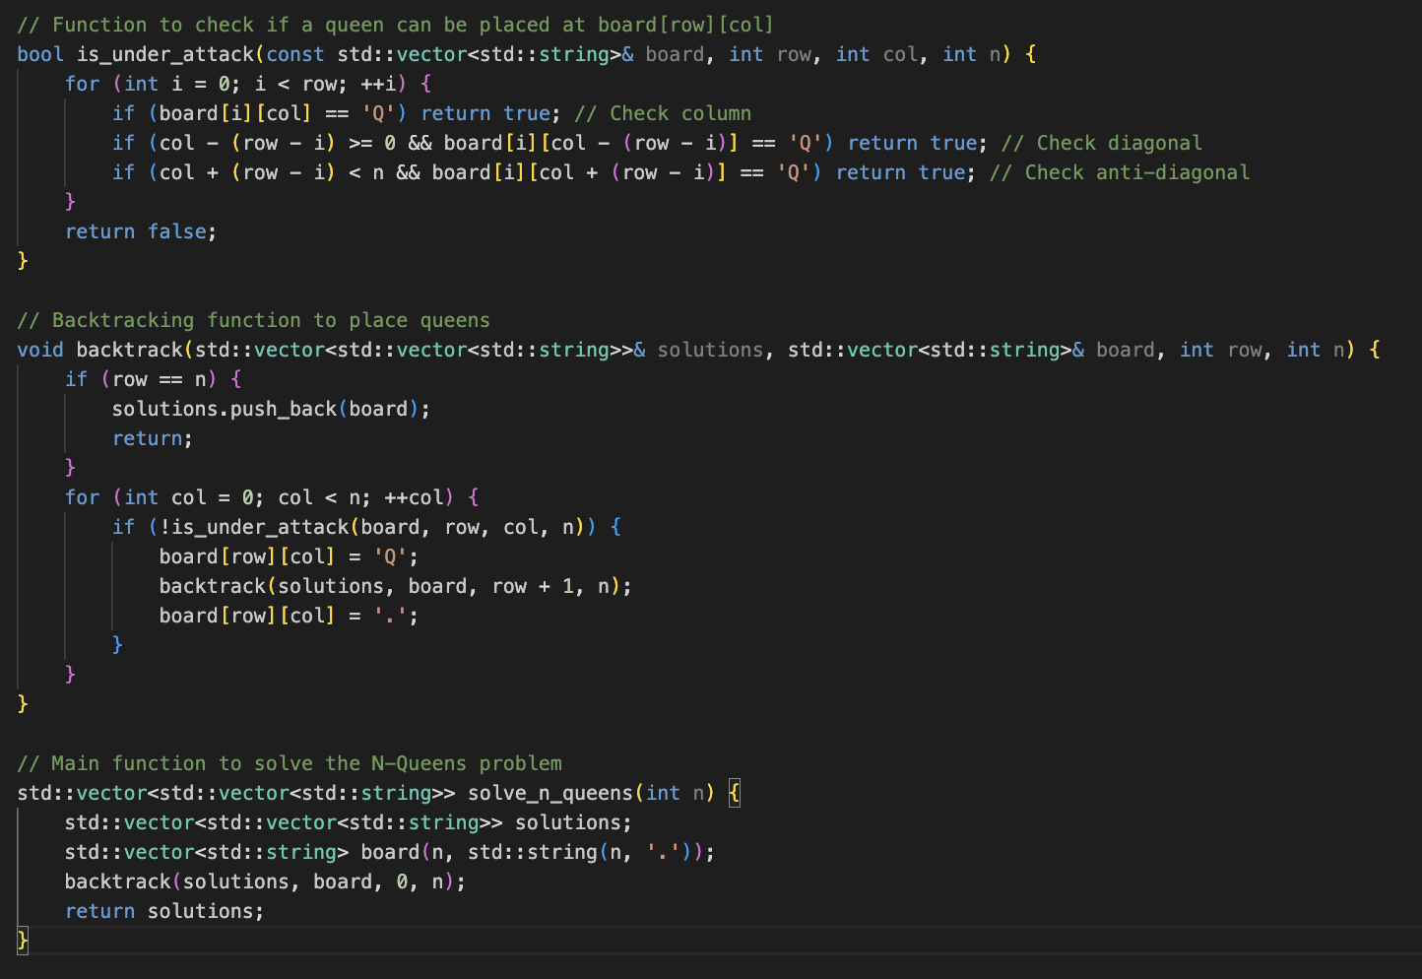

Slide 45
Divide and Conquer
What it is:
Break a problem into smaller subproblems, solve them recursively, and combine their results to solve the original problem.
When to use it:
Problems that can be divided into independent subproblems.
Examples: Merge Sort, Quick Sort, Binary Search, Closest Pair of Points.
How to detect the pattern:
Look for keywords like "divide into subproblems", "recursive solution", or "combine results".

Slide 46
Problem: Merge Sort
Problem: Sort an array using the divide-and-conquer approach.
Solution:
Divide the array into two halves.
Recursively sort each half.
Merge the two sorted halves.

